Slide 1
Mehran S. Fallah May 2020
Programming Languages
Session IV
Semantics

Slide 2
Introduction
We have seen some syntactic processes of a program.
An AST satisfying context conditions is now ready to be translated into a machine-level language, or to be interpreted.
In doing so, we need to know the meaning of programs. That is, the computation a program specifies, or the actions taken in the run-time system when a program executes.
The meaning of programs is given by the semantics of the language. There are different methods (styles) for specifying the semantics of a language.
To formalize the semantics of a language, we usually use inductive definitions.
AST Satisfying Context Conditions
Program as Text
(A Sequence of Characters)
A Sequence of Tokens
Abstract Syntax Tree
Lexical Analyzer
(Scanner)
Syntactic Analyzer
(Parser)
Semantic Analyzer)
Lexical Syntax
Phrase-Structure Syntax (BNF)
and
Abstract Syntax
Attribute Grammar, Type System, …

Slide 3
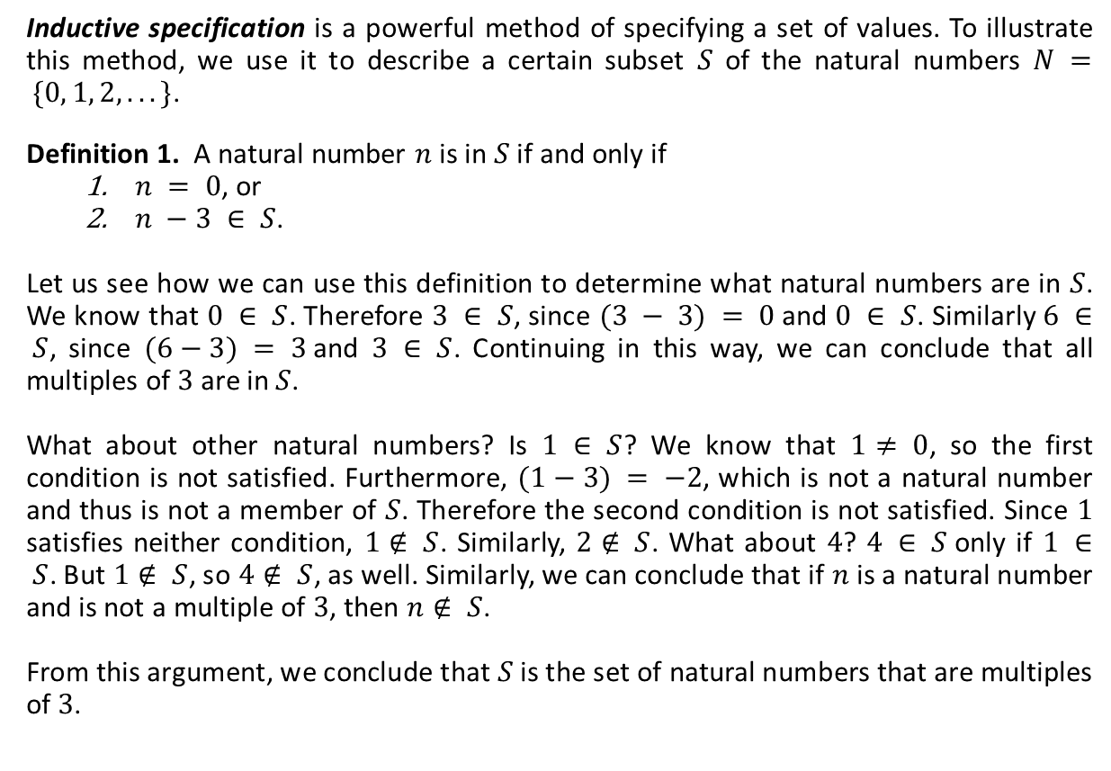
Inductive Specification
Inductive specification is a powerful method of specifying a set of values. To illustrate this method, we use it to describe a certain subset $S$ of the natural numbers $N = \{0, 1, 2, . . .\}$.
Definition 1. A natural number $n$ is in $S$ if and only if
$n = 0$, or
$n −3 ∈ S$.
Let us see how we can use this definition to determine what natural numbers are in $S$. We know that $0 ∈ S$. Therefore $3 ∈ S$, since $(3 − 3) = 0$and $0 ∈ S$. Similarly $6 ∈ S$, since $(6−3) = 3$and $3 ∈ S$. Continuing in this way, we can conclude that all multiples of $3$ are in $S$.
What about other natural numbers? Is $1 ∈ S$? We know that $1≠ 0$, so the first condition is not satisfied. Furthermore, $(1−3) = −2$, which is not a natural number and thus is not a member of $S$. Therefore the second condition is not satisfied. Since $1$ satisfies neither condition, $1∉ S$. Similarly, $2∉ S$. What about $4$? $4 ∈ S$only if $1 ∈ S$. But $1∉ S$, so $4∉ S$, as well. Similarly, we can conclude that if $n$ is a natural number and is not a multiple of $3$, then $n∉ S$.
From this argument, we conclude that $S$ is the set of natural numbers that are multiples of $3$.

Slide 4



Inductive Specification (Ctd.)
We can use this definition to write a procedure to decide whether a natural number $n$ is in $S$.
Here is an alternative way of writing down the definition of S.
Definition 2. Define the set S to be the smallest set contained in $N$ and satisfying the following two properties:
$0 ∈ S$, and
if $n ∈ S$, then $n +3 ∈ S$.
Here is yet another way of writing the definition:
in-S? : N → Bool
usage: (in-S? n) = #t if n is in S, #f otherwise
define in-S?
(lambda (n)
(if (zero? n) #t
(if (>= (- n 3) 0)
(in-S? (- n 3))
#f))))
inference rules
$$\frac{}{0∈S}$$
$$\frac{n∈S}{(n+3)∈S}$$
axiom
proper rule

Slide 5
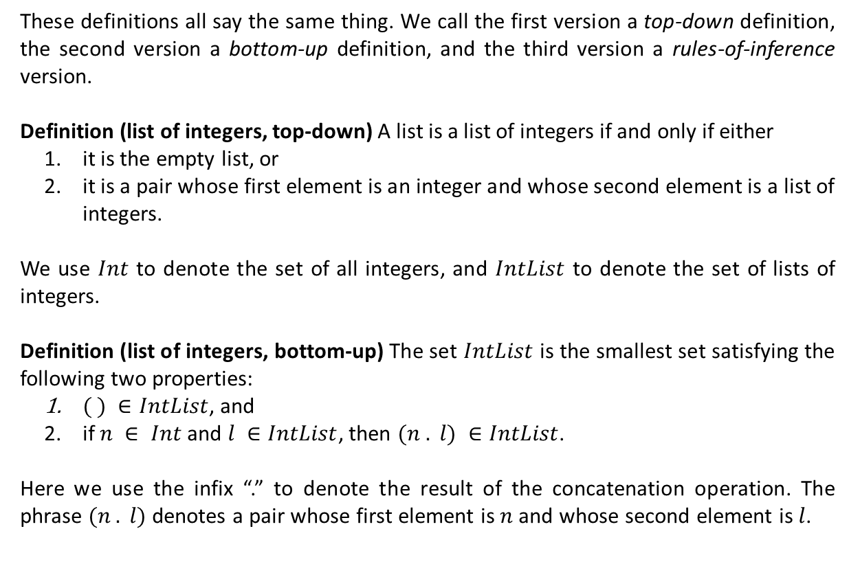
Inductive Specification (Ctd.)
These definitions all say the same thing. We call the first version a top-down definition, the second version a bottom-up definition, and the third version a rules-of-inference version.
Definition (list of integers, top-down) A list is a list of integers if and only if either
it is the empty list, or
it is a pair whose first element is an integer and whose second element is a list of integers.
We use $Int$ to denote the set of all integers, and $IntList$ to denote the set of lists of integers.
Definition (list of integers, bottom-up) The set $IntList$ is the smallest set satisfying the following two properties:
$( ) ∈IntList$, and
if $n ∈ Int$and $l ∈IntList$, then $(n . l) ∈IntList$.
Here we use the infix “.” to denote the result of the concatenation operation. The phrase $(n . l)$denotes a pair whose first element is $n$ and whose second element is $l$.

Slide 6


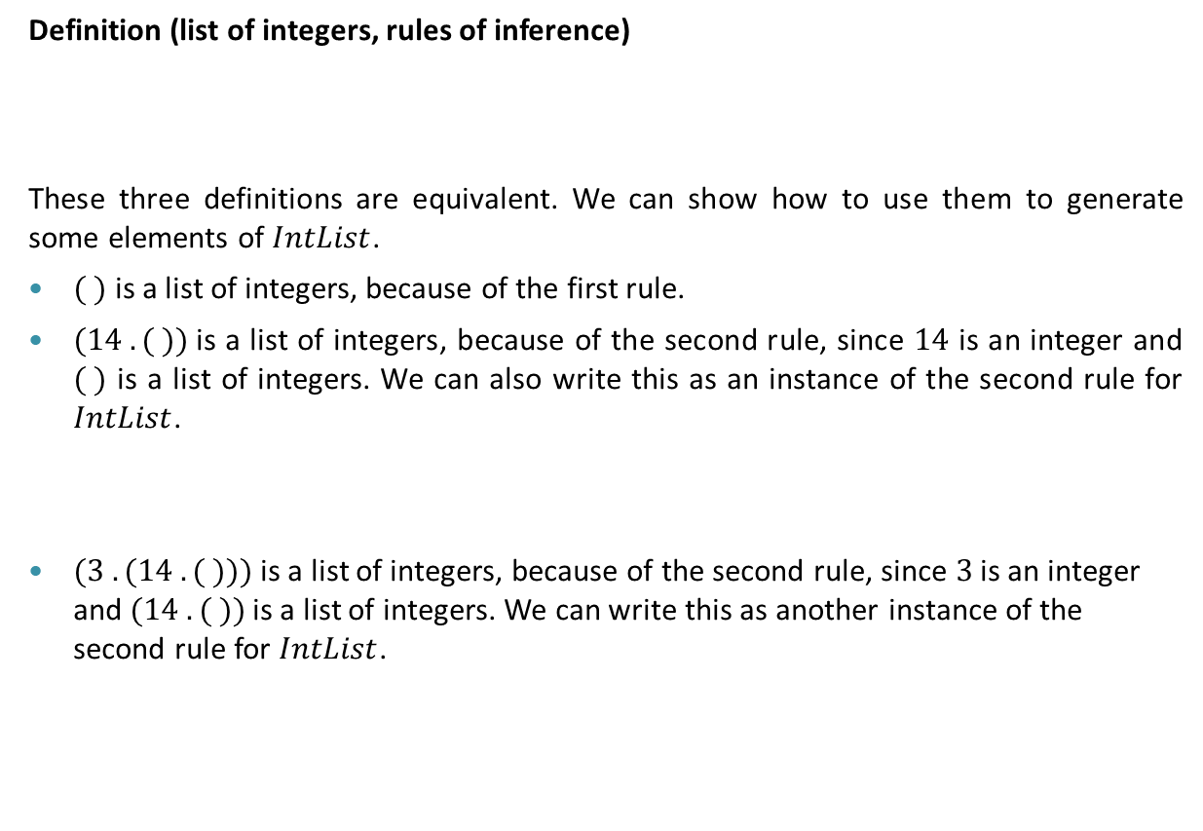


Inductive Specification (Ctd.)
Definition (list of integers, rules of inference)
These three definitions are equivalent. We can show how to use them to generate some elements of $IntList$.
$( )$ is a list of integers, because of the first rule.
$(14 . ( ))$is a list of integers, because of the second rule, since $14$ is an integer and $( )$ is a list of integers. We can also write this as an instance of the second rule for $IntList$.
$(3 . (14 . ( )))$is a list of integers, because of the second rule, since $3$ is an integer and $(14 . ( ))$is a list of integers. We can write this as another instance of the second rule for $IntList$.
$$\left( \right)∈IntList$$
$$\frac{n∈Int l∈IntList }{(n . l)∈IntList}$$
$$\frac{14∈Int ( )∈IntList }{\text{(14} . ( ))∈IntList}$$
$$\frac{3∈Int \text{(14} . ( ))∈IntList}{\text{(}\text{3 . (}\text{14} . ( )))∈IntList}$$

Slide 7


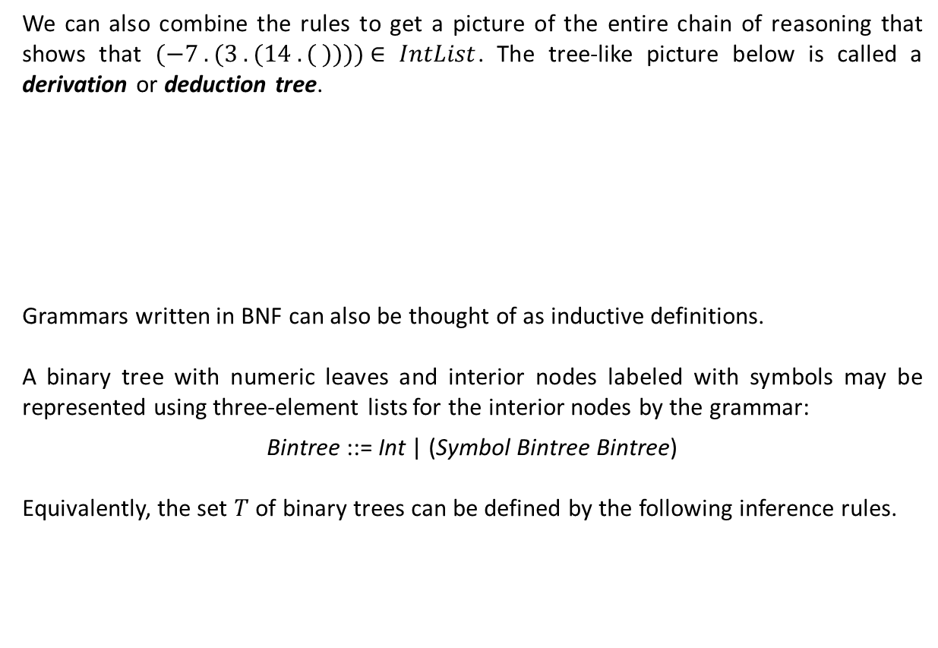





Inductive Specification (Ctd.)
We can also combine the rules to get a picture of the entire chain of reasoning that shows that $(−7 . (3 . (14 . ( ))))$∈ $IntList$. The tree-like picture below is called a derivation or deduction tree.
Grammars written in BNF can also be thought of as inductive definitions.
A binary tree with numeric leaves and interior nodes labeled with symbols may be represented using three-element lists for the interior nodes by the grammar:
Bintree ::= Int | (Symbol Bintree Bintree)
Equivalently, the set $T$ of binary trees can be defined by the following inference rules.
$$\frac{14∈Int ( )∈IntList }{\text{(14} . ( ))∈IntList}$$
$$3∈Int$$
$$−7∈Int$$
$$\text{(3 . (14} . ( )))∈IntList$$
$$(−7 . (3 . (14 . ( )))) \text{∈ }IntList$$
$$\frac{a∈Int}{a∈T}$$
$$\frac{s∈Sym t_{1}∈T { t}_{2}∈T}{\left(s t_{1} t_{2}\right)∈T}$$

Slide 8

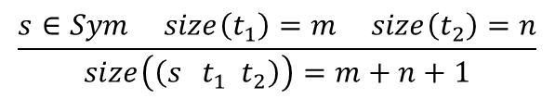


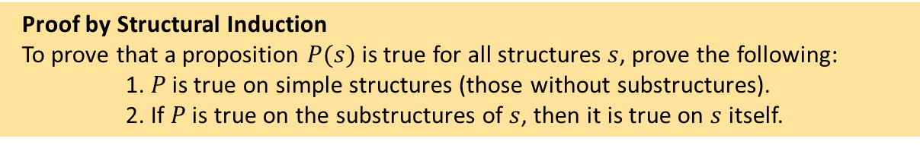
Inductive Specification (Ctd.)
$$\frac{a∈Int}{a∈T}$$
$$\frac{s∈Sym t_{1}∈T { t}_{2}∈T}{\left(s t_{1} t_{2}\right)∈T}$$
The size (the number of nodes) of a binary tree can also be defined inductively as follows:
Theorem. Let $t$ be a binary tree. Then, $t$ contains an odd number of nodes.
Proof. We must prove that if $t∈T$, then $size\left(t\right)=2k+1$ for some natural number $k$. We use induction on the structure of binary trees.
The proposition holds for $a∈T$, because $size\left(a\right)=1$ for $a∈Int$.
We must show that if the proposition holds for $t_{1}∈T$ and $t_{2}∈T$, it also holds for $\left(s t_{1} t_{2}\right)∈T$.
From the induction hypothesis we have $size\left(t_{1}\right)=2k_{1}+1$ and $size\left(t_{2}\right)=2k_{2}+1$ for some natural numbers $k_{1}$ and $k_{2}$. Thus,
$size\left(\left(s { t}_{1} t_{2}\right)\right)=\left(2k_{1}+1\right)+\left(2k_{2}+1\right)+1=2\left(k_{1}+k_{2}+1\right)+1$.
$$\frac{a∈Int}{size\left(a\right)=1}$$
$$\frac{s∈Sym size\left(t_{1}\right)=m size\left(t_{2}\right)=n}{size\left(\left(s t_{1} t_{2}\right)\right)=m+n+1}$$
Proof by Structural Induction
To prove that a proposition $P(s)$ is true for all structures $s$, prove the following:
1. $P$ is true on simple structures (those without substructures).
2. If $P$ is true on the substructures of $s$, then it is true on $s$ itself.
induction hypotheses

Slide 9










An Example: Arithmetic Expressions
The following is the grammar of a language containing boolean constants true and false, conditional expressions, the numeric constant 0, the arithmetic operators succ (successor) and pred (predecessor), and a testing operation iszero that returns true when it is applied to 0 and false when it is applied to some other number.
The above grammar is actually just a compact notation for the following inductive definition:
t ::= terms:
true constant true
false constant false
if t then t else t conditional
0 constant zero
succ t successor
pred t predecessor
iszero t zero test
true$∈E \text{false} ∈E \text{0} ∈E$
Axioms
$$t_{1} ∈E$$
$$t_{1} ∈E$$
$$t_{1} ∈E$$
succ $t_{1}∈E$
pred $t_{1}∈E$
iszero $t_{1}∈E$
Proper Rules
$$t_{1} ∈E$$
$$t_{2} ∈E$$
$$t_{3} ∈E$$
If $t_{1}$ then $t_{1}$ else $t_{1}∈E$

Slide 10
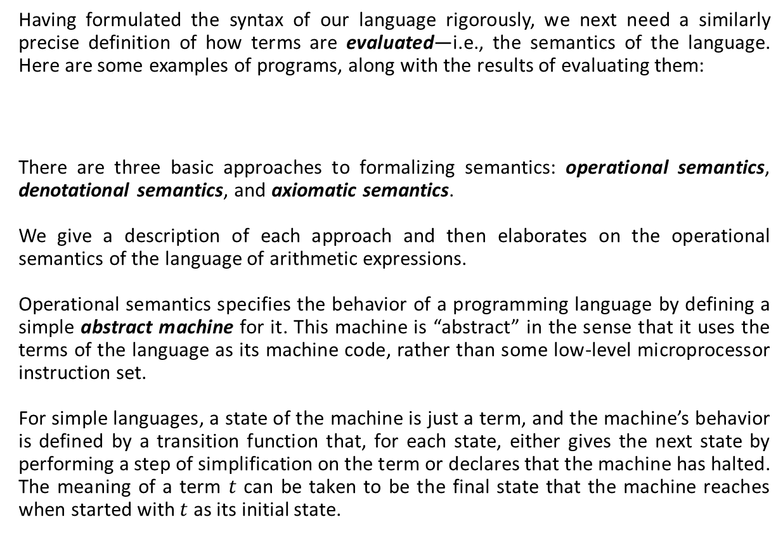


Semantics
Having formulated the syntax of our language rigorously, we next need a similarly precise definition of how terms are evaluated—i.e., the semantics of the language. Here are some examples of programs, along with the results of evaluating them:
There are three basic approaches to formalizing semantics: operational semantics, denotational semantics, and axiomatic semantics.
We give a description of each approach and then elaborates on the operational semantics of the language of arithmetic expressions.
Operational semantics specifies the behavior of a programming language by defining a simple abstract machine for it. This machine is “abstract” in the sense that it uses the terms of the language as its machine code, rather than some low-level microprocessor instruction set.
For simple languages, a state of the machine is just a term, and the machine’s behavior is defined by a transition function that, for each state, either gives the next state by performing a step of simplification on the term or declares that the machine has halted. The meaning of a term $t$ can be taken to be the final state that the machine reaches when started with $t$ as its initial state.
if false then 0 else 1;
iszero (pred (succ 0));
$⊳$ 1
$⊳$ true

Slide 11
Semantics (Ctd.)
Strictly speaking, what we are describing here is the so-called small-step style of operational semantics, sometimes called structural operational semantics (Plotkin, 1981)
Denotational semantics takes a more abstract view of meaning: instead of just a sequence of machine states, the meaning of a term is taken to be some mathematical object, such as a number or a function. Giving denotational semantics for a language consists of finding a collection of semantic domains and then defining an interpretation function mapping terms into elements of these domains. The search for appropriate semantic domains for modeling various language features has given rise to a rich and elegant research area known as domain theory.
Axiomatic semantics takes a more direct approach to the laws for proving that two programs have exactly the same behavior: instead of first defining the behaviors of programs (by giving some operational or denotational semantics) and then deriving laws from this definition, axiomatic methods take the laws themselves as the definition of the language. The meaning of a term is just what can be proved about it.
The beauty of axiomatic methods is that they focus attention on the process of reasoning about programs.
Operational semantics has become an energetic research area in its own right and is often the method of choice for defining programming languages and studying their properties.

Slide 12

Semantics (Ctd.)
Leaving numbers aside for the moment, let us begin with the operational semantics of just Boolean expressions.
The left-hand column of the following figure is a grammar defining two sets of expressions. The first is just a repetition (for convenience) of the syntax of terms. The second defines a subset of terms, called values, that are possible final results of evaluation. Here, the values are just the constants true and false. The metavariable v is used to stand for values.
The right-hand column defines an evaluation relation (reduction) on terms, written $t⟶t′$. and pronounced “$t$ evaluates to $t′$ in one step.” The intuition is that, if $t$ is the state of the abstract machine at a given moment, then the machine can make a step of computation and change its state to $t′$. This relation is defined by three inference rules.
computation rules
congruence (search) rule

Slide 13
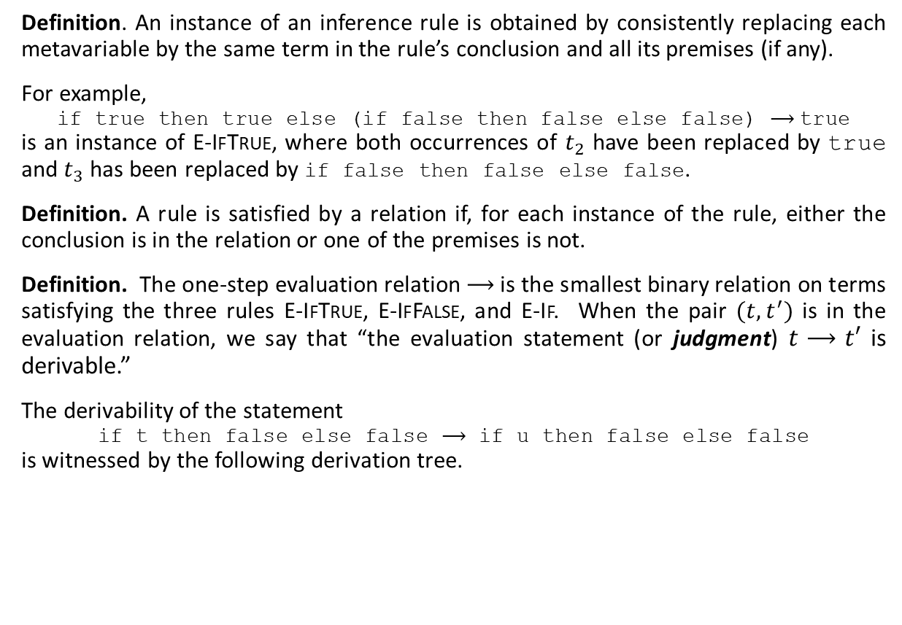
Semantics (Ctd.)
Definition. An instance of an inference rule is obtained by consistently replacing each metavariable by the same term in the rule’s conclusion and all its premises (if any).
For example,
if true then true else (if false then false else false) $⟶$true
is an instance of E-IfTrue, where both occurrences of $t_{2}$ have been replaced by true and $t_{3}$ has been replaced by if false then false else false.
Definition. A rule is satisfied by a relation if, for each instance of the rule, either the conclusion is in the relation or one of the premises is not.
Definition. The one-step evaluation relation $⟶$ is the smallest binary relation on terms satisfying the three rules E-IfTrue, E-IfFalse, and E-If. When the pair $(t,t^{′})$ is in the evaluation relation, we say that “the evaluation statement (or judgment) $t⟶t′$ is derivable.”
The derivability of the statement
if t then false else false $⟶$ if u then false else false
is witnessed by the following derivation tree.

Slide 14
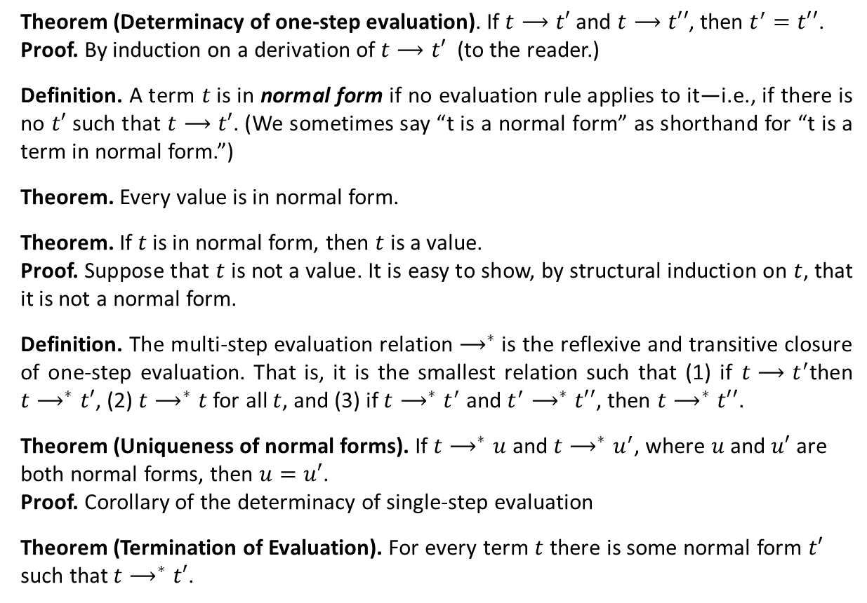
Semantics (Ctd.)
Theorem (Determinacy of one-step evaluation). If $t⟶t′$ and $t⟶t′′$, then $t^{′}=t′′$.
Proof. By induction on a derivation of $t⟶t′$ (to the reader.)
Definition. A term $t$is in normal form if no evaluation rule applies to it—i.e., if there is no $t′$ such that $t⟶t′$. (We sometimes say “t is a normal form” as shorthand for “t is a term in normal form.”)
Theorem. Every value is in normal form.
Theorem. If $t$ is in normal form, then $t$ is a value.
Proof. Suppose that $t$ is not a value. It is easy to show, by structural induction on $t$, that it is not a normal form.
Definition. The multi-step evaluation relation $⟶^{∗}$ is the reflexive and transitive closure of one-step evaluation. That is, it is the smallest relation such that (1) if $t⟶t^{′}$then $t⟶^{∗}t′$, (2) $t⟶^{∗}t$ for all $t$, and (3) if $t⟶^{∗}t^{′}$ and $t^{′}⟶^{∗}t′′$, then $t⟶^{∗}t′′$.
Theorem (Uniqueness of normal forms). If $t⟶^{∗}u$ and $t⟶^{∗}u^{′}$, where $u$ and $u′$ are both normal forms, then $u=u′$.
Proof. Corollary of the determinacy of single-step evaluation
Theorem (Termination of Evaluation). For every term $t$ there is some normal form $t′$ such that $t⟶^{∗}t′$.

Slide 15
Semantics (Ctd.)
Now, we extend the definition of evaluation to arithmetic expressions.

Slide 16

Semantics (Ctd.)
Definition. A closed term is stuck if it is in normal form but not a value.
The terms pred true and succ false are stuck.
An alternative style, called big-step semantics (or sometimes natural semantics), directly formulates the notion of “this term evaluates to that final value,” written $t⇓v$. The big-step evaluation rules for our language of Boolean and arithmetic expressions look like this:

Slide 17
Essentials of Programming Languages by Daniel P. Friedman and Mitchell Wand (Chapter 1)
Types and Programming Languages by Benjamin Pierce (Chapter 3)

